Slide 1


Web application course
AI APPLICATION
PROJECT
PRESENTATION
Presented by:AIBIO TEAM

Slide 2
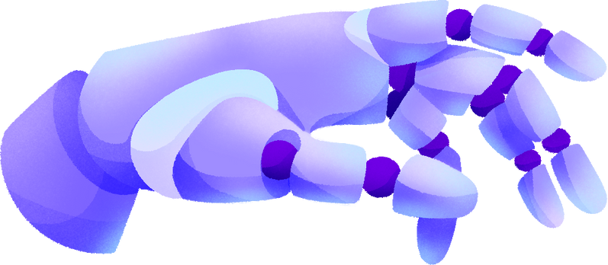
TABLE OF CONTENTS
Introduction
Project Statements
Solutions
Product Development
Conclusion
03
04
05
06
25

Slide 3
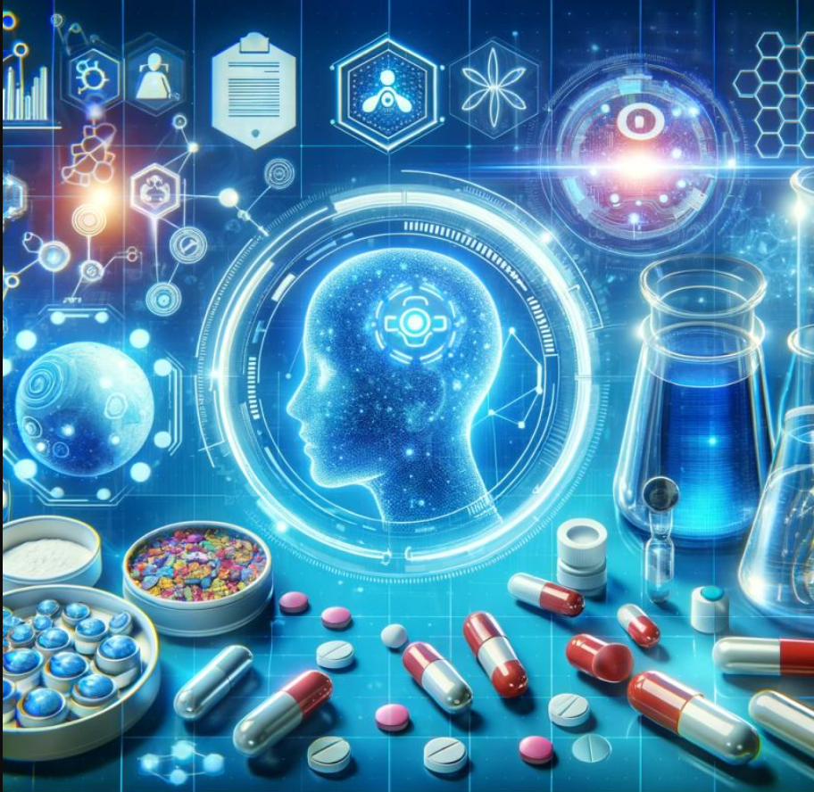
Introduction
Objective: Create a website that facilitates drug development by integrating AI models.
Shorterm Goals
Longterm Goals
Expand Data Integration
Build the Website
Longterm Goals
Enhance AI Capabilities
Add AI Tools
Longterm Goals
Launch and Gather Feedback
Collaborative
Ecosystem

Slide 4



Problem Statement
High costs (average $2.6 billion per drug).
Long timelines (10–15 years per drug).
High failure rates in clinical trials (~90%).

Slide 5

Solutions
Approach 1
Integration of AI models for data analysis, prediction, and optimization.
Approach 2
User-friendly interface for researchers and pharmaceutical companies.
Approach 3
Gathering as much as Biology data.

Slide 6
01
Developed tools
02
Development phases
Product Development
03
Software architechture
04
Workflow diagram
05
Usecase Diagram
06
Entities Relational Diagram
07
Considerable Features

Slide 7

Developed Tools
1 Backend
4 Design system
-Python
-Drawio
-Sqlalchemy
5 Teamwork
-Flask Framework
-Github
2 Frontend
6 References
-HTML
-ARIV Papers
3 Deployment
-Deepchem
-NGrok
-Hugging Face

Slide 8
Gather Customer Requirements
Development
Phases
Feedback and Update
Research and Implement Features
Intergrate into Platform
and Deploy

Slide 9
System architechture
1 The main core based on MVC
2 Allow parallel develop components without delay
3 Easier to expand ,maintain for developers

Slide 10
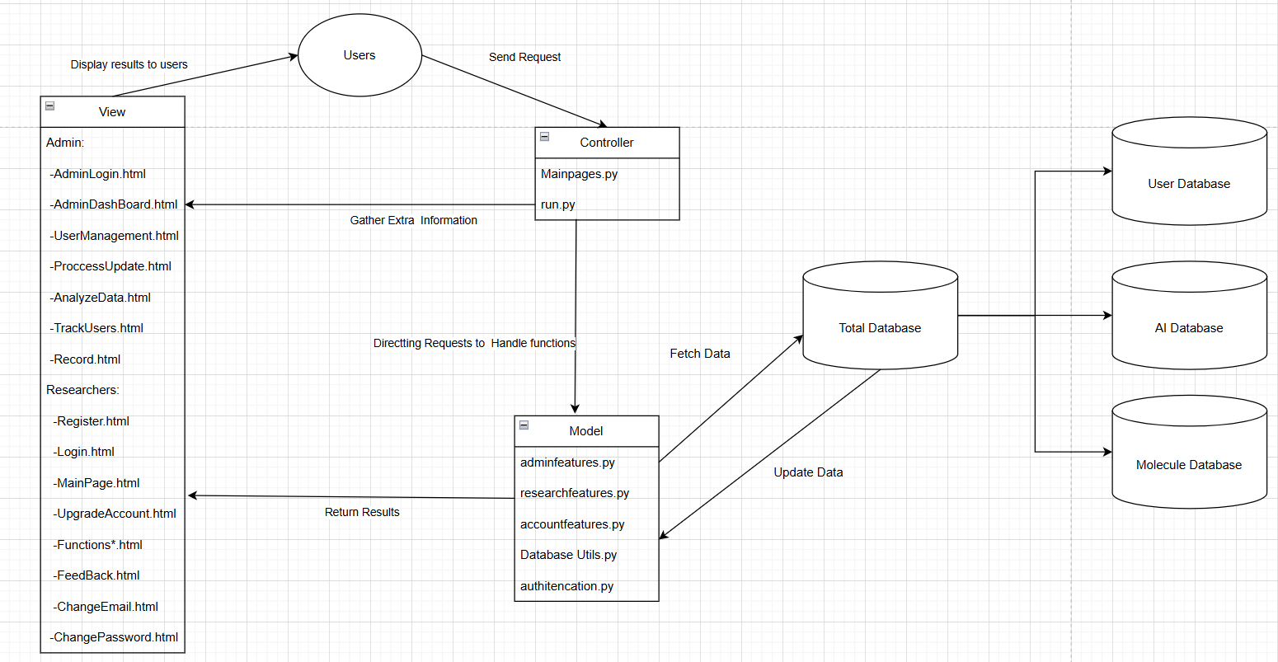
Software architechture

Slide 11
Workflow diagram
1 Generally describe the behavior of main Actors in system.
2 Cover all features and aspects of system for developers.
3 Ensure my team develop and intergrate features logically.

Slide 12
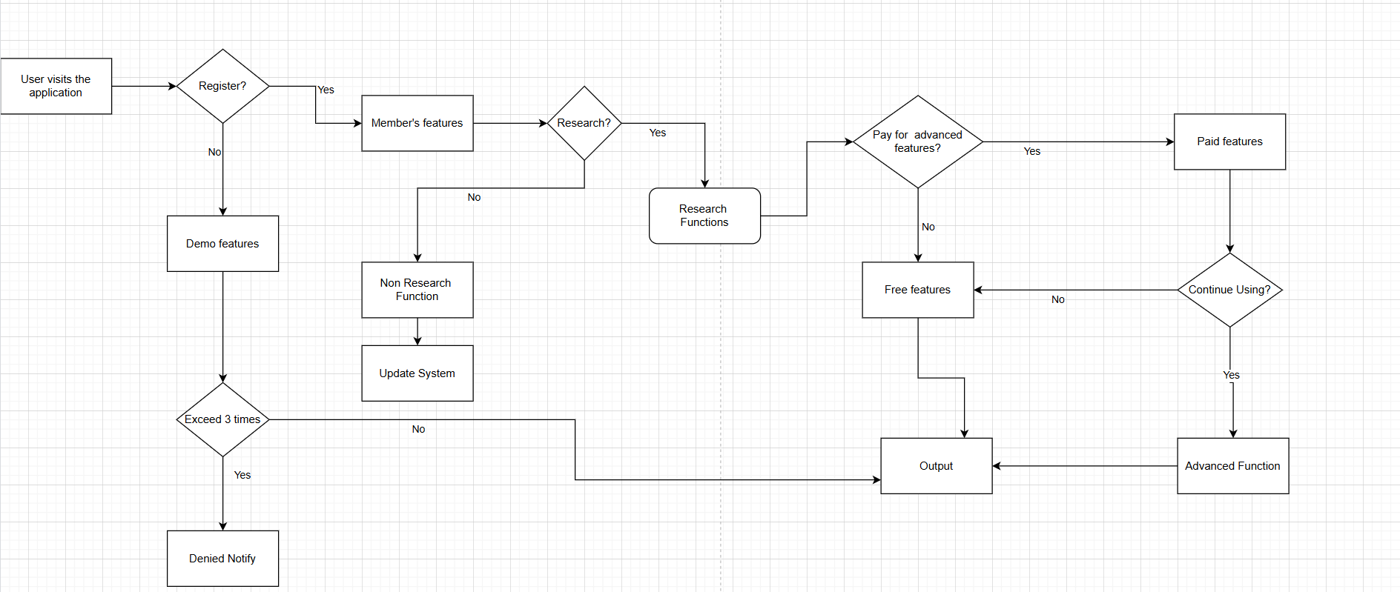
User Workflow

Slide 13
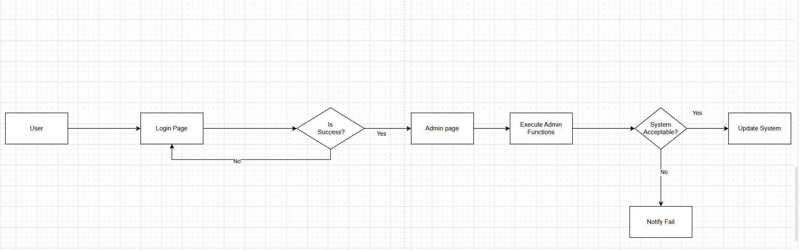
Admin Workflow

Slide 14
Use case diagram
1 Depict how the interaction between components
2 Depict fully features for users .
3 Help IT team develop system effectively.

Slide 15
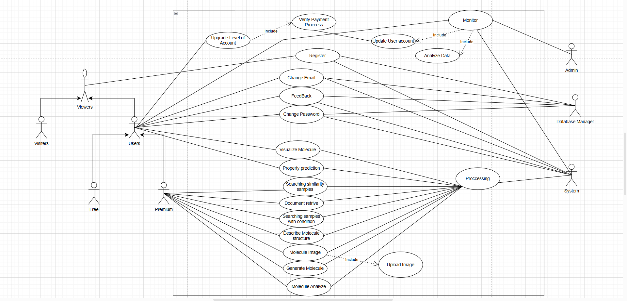
Use Case Diagram

Slide 16
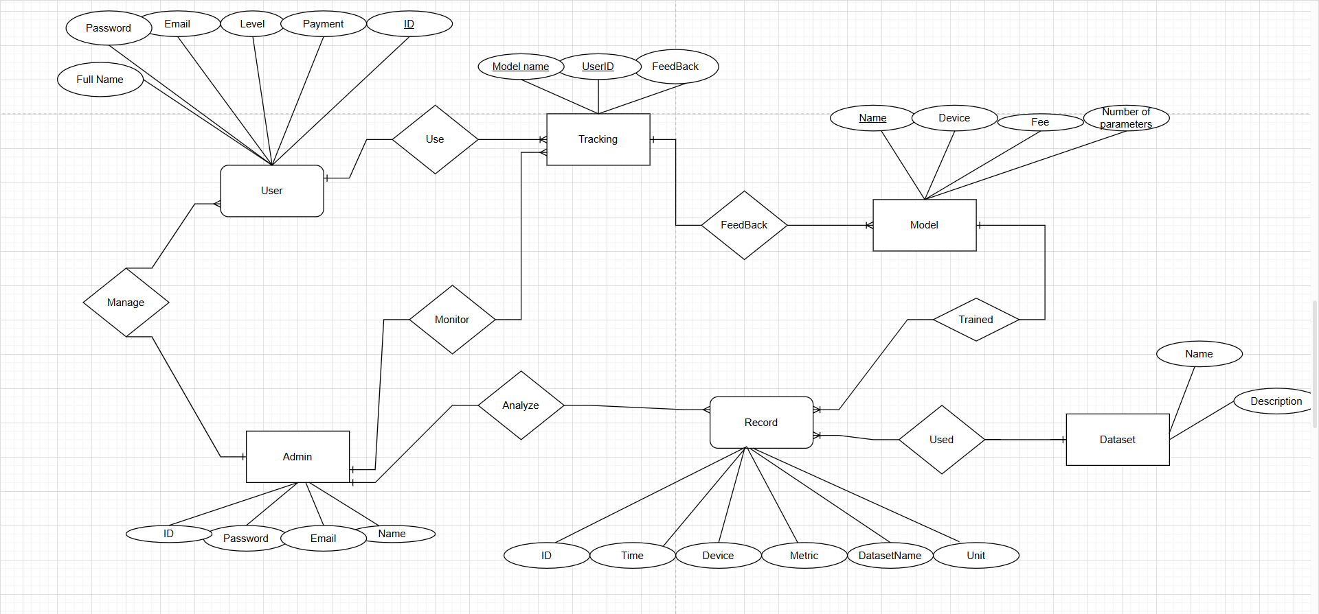
Entities Relationship Diagram

Slide 17
Considerable Features
1 Intergrate AI technology to increase user’s features.
2 Improve existing method to upgrade accuracy.
3 Various Database and tasks to serve researchers.

Slide 18
Search Documents
1 Popular and famous papers fo researchers
2 Diversity papers
3 Intergrate NLP model for increase accuracy
4 Responding time meet the user’s satisfaction

Slide 19
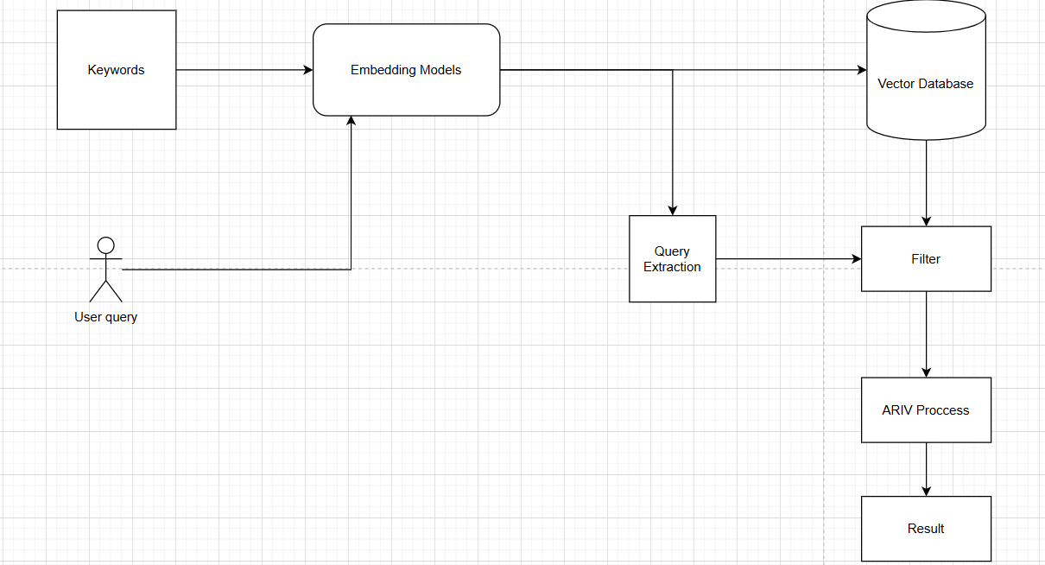
Search Engine intergrate with NLP model

Slide 20
Search Molecules
1 Find molecules based on Properties similarity.
2 Diversity of substances in database.
3 High Quality Model used for feature extraction.
4 Execute time fast and friendly with users.

Slide 21
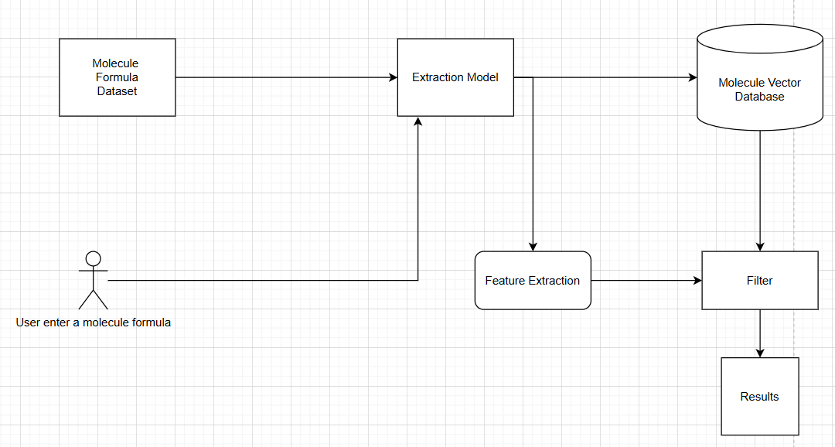
Search Molecules based on User’s condition

Slide 22
Search Molecules based on User’s condition
1 Find molecules based on User’s satisfaction.
2 Improve technique to find less than 10 seconds.
3 Users can flexibily setup their conditions.
4 Wide range database with nearly 40000 samples space.

Slide 23
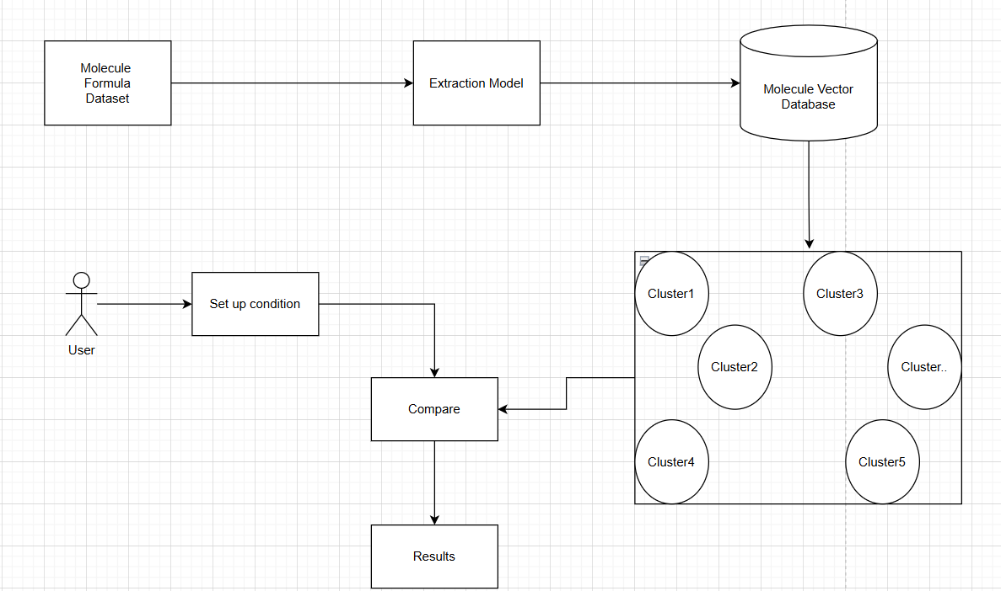
Search Molecules based on User’s condition

Slide 24
High Flexibility for Users
1 Allow researchers work with Image and Formula .
2 Multiple input types help improve accuracy of features.
3 Multiple output allow researchers analyze various aspects of Molecule.

Slide 25
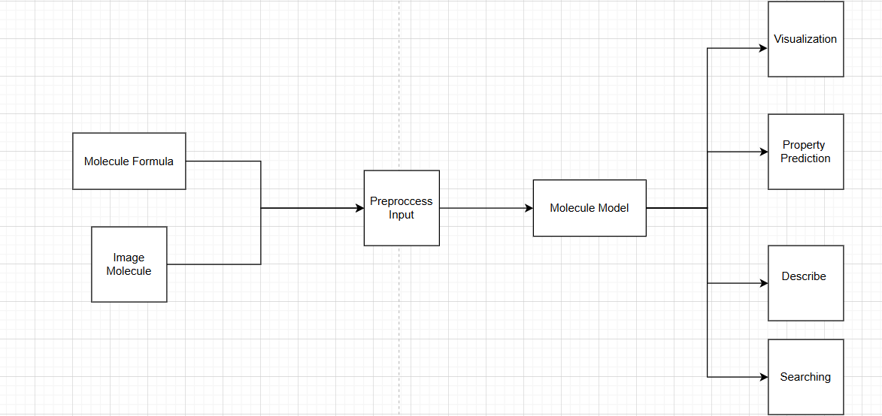

Slide 26
Conclusion
Achievements
1 Fully website system with features serve for drug researchers.
2 Successful integrate AI models for increase user’s satisfaction.
3 Improve some existing approach for upgrade system.

Slide 27
Limitations
1 Users and Admin must manually handle some tasks.
2 Diversity of database need to be expanded more .
3 System should be improved to upgrade User’s feeling.

Slide 28




THANK YOU
CONNECT WITH US.
+84-965-4719
ntt1179@gmail.com

